Slide 1
ACT inside ABA
How Did We Get Here and Where Are We Going?

Slide 2
Abstract: Moving forward with an examination of behavioral functions from an ACT perspective, while understanding the role of relational framing and transformation of stimulus functions, can better equip behavior analysts to effectively address complex maladaptive covert verbal behavior leading to maladaptive overt behavior. This may be one way that behavior analysts can move towards a more comprehensive analysis of behavior, and may result in more effective interventions for socially significant change.

Slide 3
ACT
Functional Contextualism
Relational Frame Theory
Applied Behavior Analysis
Acceptance and Commitment
Notes:
Thus ACT teaches people to increase awareness of their own behavior (both public and private), and to notice how it functions in the context of their life. ACT is inextricably linked to Relational Frame Theory. Over the last 25 years, ACT and RFT have progressed together - When combined, they provide a way forward to help us effectively treat more and more complex behavioral problems.
Behavior analysis involves the study of any variables that affect the probability of behavior (Biglan & Kass, 1977; Skinner, 1969)

Slide 4
Relational Frame Theory
Steve Hayes, ACBS:
“The overarching aim of this behavioral research has been to integrate a range of apparently diverse psychological phenomena including…stimulus equivalence, naming, understanding, analogy, metaphor, and rule-following”
https://contextualscience.org/what_is_rft

Slide 5
So, how did we get here?
What do I REALLY need to know?
Notes:
We got to where we are at now by the ongoing research of those in both the ACT and RFT fields. While technically they developed together over the few decades, RFT is essential to an understanding of VB from an ACT perspective. I want to say also that I am going to oversimplify the theory for the purposes of public consumption but please feel free to reach out after for more information on RFT.

Slide 6
Derived Relational Responding
Learned, operant behavior.
Responding that is derived - Cannot be accounted for by conditional discrimination.
Also describes multitudes of different types of responding; not just equivalence.
Notes:
DRR basis of generative responding - Dr. Siri Ming discussion Sat morning.
Responding between relations is crucial for language development.

Slide 7
Relational Responding - Families of Frames
Frames of Coordination – identity, sameness,
Frames of Opposition – opposites
Frames of Distinction – lack of coordination along a particular dimension
Frames of Comparison – bigger/smaller, faster/slower, better/worse
Hierarchical Frames – Belong to a group, hierarchy
Deictic Frames – perspective of speaker (here/there, I/you, now/then)
Spatial/temporal/causal etc.
Notes:
Hierarchical frames – family tree is a great example and as you can see, can get very complex. like classes that contain members on different levels.
Might be controlled in natural language by combinations of contextual cues, such as “is part of”, “is similar to”, and “is distinct from

Slide 8
Derived Relational Responding
AARRing
Learned, operant behavior.
Responding that is derived - Cannot be accounted for by conditional discrimination.
Also describes multitudes of different types of responding; not just equivalence.
Type of relational responding
Abstract response patterns
Not based on formal properties of a stimulus/stimuli
Under the control of contextual cues

Slide 9
Derived Relational Responding
AARRing
Transformation of Stimulus Function
Learned, operant behavior.
Responding that is derived - Cannot be accounted for by conditional discrimination.
Also describes multitudes of different types of responding; not just equivalence.
Type of relational responding
Abstract response patterns
Not based on formal properties of a stimulus/stimuli
Under the control of contextual cues
Functions of one stimulus changes by virtue of its relationship to another stimulus.
Notes:
Aarr - Patterns of relational frames

Slide 10
Transformation of Stimulus Functions
Client Bitten by Dog
Dogs are aversive
Family member compares dogs to Children
"I regret getting a dog at the same time as the new baby arrived. They both cry so much and need constant attention!"
Dogs and Children
Frame of Coordination
Aversive functions of dogs transfer to children.
Notes:
Making relational responses between stimuli results in transformation of stimulus functions for all of the stimuli involved.
When two stimuli are related, some of the functions of each stimulus change according to what stimulus it is related to, and how it is related to that stimulus.

Slide 11
Relational Framing – Language & Maladaptive Behavior
Panic
Nervous Sensations
Kids at School
Panic
Nervous Sensations
Notes:
We can experience distress even when we are only imagining an aversive thing.
So what if something our clients want to avoid comes from the inside (e.g. panic attack).
So then it is entirely conceivable that anything that causes nervous physical sensations can enter a frame of coordination with “panic” Thanks to bi-directionality, physical sensations can enter a frame of coordination with “panic attack” and so we can learn to avoid them
If seeing certain kids at school causes a racing heart, that can summon the idea of panic, which is to be avoided. We can therefore learn to avoid going to school and avoid seeing the kids and therefore avoid those aversive nervous sensations.

Slide 12
ACT
Memory of an aversive event can evoke more distress than the actual event did.
Imagined event can cause distress even though the person has never experienced it.
All because of the *Bi-directionality in language*.
Notes:
(If you’ve ever worried about your own death, you know what I mean!). We have an added edge because we understand the complexities of language and how futile it is to just say, don’t think about it.
A LOT of in depth work that is being done in the therapeutic community, Psychotherapy, etc. however, I want to keep this relevant to applied behavior analysis. I do recommend getting in to ACT for yourself. It really helps to be able to engage with the literature on a personal level with an understanding of our own verbal processes.

Slide 13
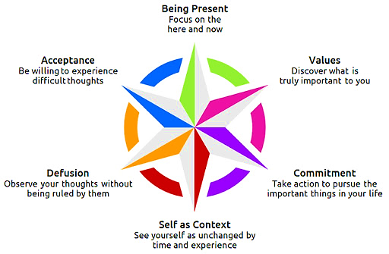
ACT
Aim: Increase psychological flexibility to either change or persist in behavior that is consistent with our values.
Acceptance and Commitment Training (ACTr)
Applicability within ABA
Notes:
ACTraining has started to be used outside of psychotherapy settings and may be much more appropriate to the field of behavior analysis.

Slide 14
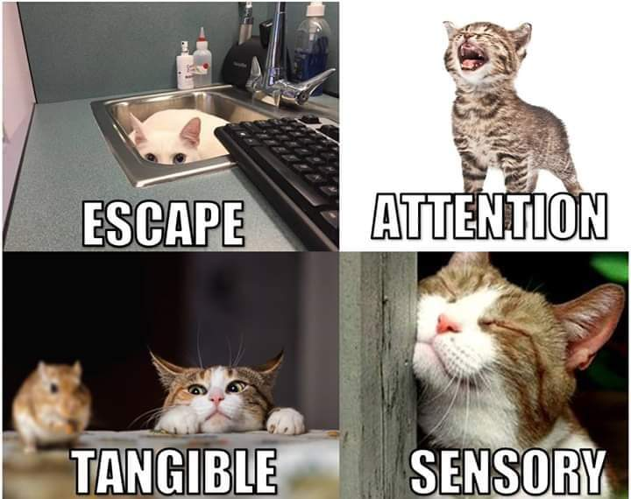
Functions of Behavior
A behavior that a person repeatedly engages in, which serves some kind of purpose or function for them (O’Neill et al., 1997)
Notes:
Talk about DCM here. If DCM works, then that is great! We do NOT need to jump to an ACT type approach to a behavioral problem if it is not necessary.
Repertoire, rigid control, get away from things.
Functional relationship between context and behavior. Learning that is not about getting away or seeking out.
Responsibility as practicing behavior analysts

Slide 15
ACTr – Expanding Functions of Behavior in ABA
ACT 4 HFA Workshop, Szabo & Tarbox, 2020; Hoffman et al., 2016; Little et al., 2020; Matsuda et al., 2020.
Notes:
Indirect acting funcitons.

Slide 16
Private Events as Functions of Behavior
Function: Experiential Avoidance
Avoiding or altering form/frequency of aversive thoughts and feelings (Hayes, Wilson et. al, 1996)
Possible relevant frames – coordination, opposition, distinction, comparison – depends on context.
Target Behavior: Avoiding short term aversive thoughts/feelings that lead to maladaptive functioning
May result in less contact with large, long term reinforcers
Replacement:
Tolerate the presence of aversive thoughts/feelings - continue to engage in constructive behaviors despite presence of aversive thoughts/feelings.
Notes:
Atypical on Netflix – Sam going to college! My client PW.
Prefer to speak of covert “responses” rather than covert “behaviors,” taking the latter to mean relations among responses and stimuli; therefore, they are not necessarily fully covert (e.g., verbal behavior may involve a covert response under the control of public stimuli; an instance of problem solving may involve both covert—precurrent—and overt responses)

Slide 17
Private Events as Functions of Behavior
Function: Rigid Focus on Past/Future)
Paying attention to things out of control – e.g. past/future; lack of present moment awareness.
Possible relevant frames – temporal, deictic, comparison, etc.
Target Behavior: Rigid attention to past/future. Inability to orient to present moment.
Replacement Behaviors:
Experience environmental contingencies directly = engage in behavior that is functional at the moment (Hoffman et. al, 2016)
Attend to relevant stimuli, respond to relevant stimuli
Self management – mindfulness practice: allow a thought to pass, then bring awareness back to the present. (ACT 4 HFA Workshop, Szabo & Tarbox).
Notes:
Restricted repetitive behaviors – defining feature of autism according to DSM.
Paying attention to present moment stimuli is a behavioral skill repertoire that can be strengthened and generalized through practice and reinforcement across multiple tasks, settings, times of day, and sensory modalities (Little, Tarbox, & Alzaabi, 2020).

Slide 18
Private Events as Functions of Behavior
Function: Fusion
Belief that all thoughts are true. Responses to private events as if they were physical stimuli in the environment (Hoffman, et al., 2016).
Target Behavior: Rigid rule control (e.g. “have to be right”, “I’m dumb”, this is just how it is”).
Target bx may include vocal responses as defined above.
Replacement:
Weakening rigid rule control, responding flexibly to aversive private events (Little et al, 2020).
Defusion: Understand that thoughts are just thoughts. “I’m having the thought that” Szabo, 2020. ACT 4 HFA Workshop, Szabo & Tarbox.
Notes:
Coordination, opposition, causal, etc. etc. just depends on context
“The bug is going to kill me”

Slide 19
Private Events as Functions of Behavior
Function: Unclear/Lack of Values
Unclear values/direction, lack of awareness or understanding of values
Target Behavior: Lack of control of verbally constructed long term reinforcers (Values); inability to tact direction or purpose.
Replacement:
Engage with rules for purpose to access potent delayed reinforcers.
Presence of augmentals (see Torneke et al. 2008).
Knowing values, engaging in behaviors that bring us closer to values.
ACT 4 HFA Workshop, Szabo & Tarbox, 2020
Notes:
(Contacting values statements which transform function of stimuli in daily life, maintains bx for prolonged durations of time).
Augmentals: verbal rules that increase the value of delayed conditioned reinforcers and immediately evoke behavior with respect to them. E.g. fail to prepare, prepare to fail
But if the child follows the rule “eating vegetables to be a big and strong boy or a nice and good boy,” then he is augmenting. Augmentals do not only specify contingencies that have not been experienced and now are contacted, but also consequences that are abstract and do not have to be directly contacted to exert control over behavior

Slide 20
Private Events as Functions of Behavior
Function: Self as Content
Inflexible perspective taking. Thinking about oneself or another person as only being a certain way, or being defined by a certain facet (i.e. conceptualized self; Hoffman et. al, 2016)
Target Behavior: Rigid rules regarding “who” self or others is/are.
Replacement: Flexible perspective taking – deictic frames. I-YOU, NOW-THEN, HERE-THERE.
(Szabo, 2020. ACT 4 HFA Workshop, Szabo & Tarbox).
General perspective taking
E.g. Self as context: I am different “people” in different contexts and can shift in an adaptive way.
Notes:
Frames: deictic, temporal,

Slide 21
Private Events as Functions of Behavior
Function: Lack of Committed Action
Inability or lack of motivation to engage in adaptive actions required to contact long term reinforcers.
Target Behavior: Inaction, inability to identify, or refusal to engage in, adaptive behaviors necessary to contact long term goal.
Replacement behaviors:
Identification of behaviors that will aid client in reaching long term goal
Presence of augmentals
Engagement with behaviors that will move client towards values
Ability to access reinforcement by engagement in these behaviors.
(Hoffman et. al, 2016)

Slide 22
Towards FA of Indirect Acting Functions
Functional analysis consistent with established ABA practices.
Utilize known ABA assessment methods, and applying those methods to indirect acting functions in an ABA context
Proposed methods are thoroughly in line with behavior analytic practice
If direct acting contingencies have been minimally effective or ineffective, the behavior analyst would conduct a descriptive functional assessment = hypothesized IA functions.
Then FA:
Present establishing operations (EO) in the form of vocal stimuli (statements) which, based on the hypothesized function, would result in vocal behavior that would affirm or refute the hypothesized function.
Notes:
In addition to work already done on verbal functional analysis in ACT (Barnes-Holmes et al., 2020; Y. Barnes-Holmes et al., 2018)
Experimental manipulation of variables the occasion or do not occasion a certain behavior.

Slide 23
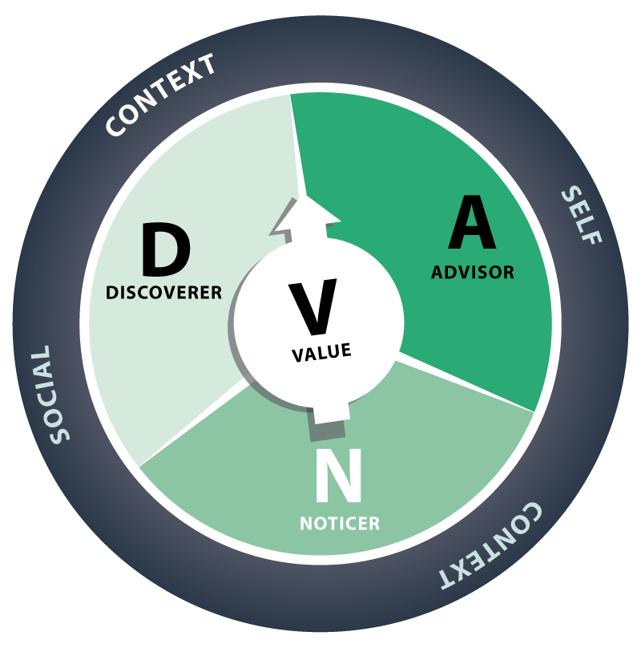
Intervention
Notes:
Thriving adolescent website there are a ton of free resources on there.

Slide 24
Dixon & Paliliunas, 2017
Use of ABA, Mindfulness & ACT
Includes daily lessons
Data recording sheets specific to the curriculum
Simple assessment to identify psychological flexibility - CPFQ

Slide 25
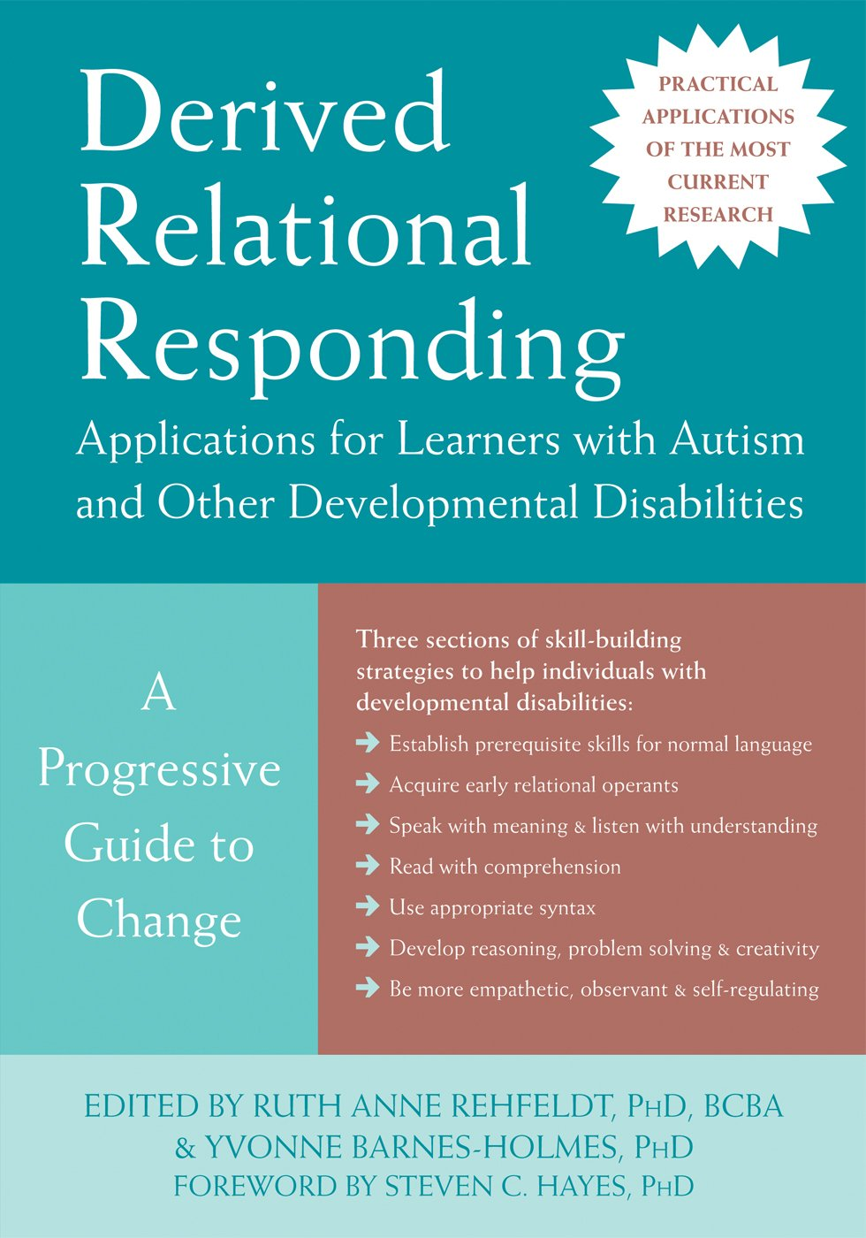
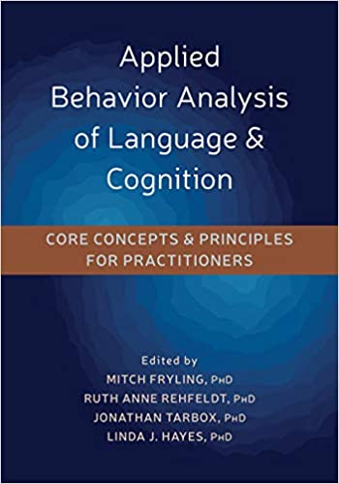
Training & Intervention
Notes:
Early learners: experience multiple exemplars during natural language interactions
Earliest generalized relational operants described by Luciano et al. in Rehfeldt & Barnes Holmes, 2009. And how to teach them (CH8)
Chapter 10 – equivalence based instruction. Designing instruction using stimulus equivalence, Chapter 11 – teaching complex relational operants of analogy (deriving equivalence relations between derived relations e.g. chair is to stool like glove is to sock) and hierarchy.

Slide 26
Intervention
Defusion – Noticing thoughts
Antecedent | Naturally occurring during the session, capture opportunity and present Vocal Sd: "Let's notice some of our thoughts right now. Tell me something that your mind is telling you."
Prompt: | Current prompt: Full vocal prompt for saying "my mind is telling me" and prompt to say why his mind might be telling him the thought. (Client should independently identify what the thought is).
Behavior: | Client vocally expresses statement such as “My mind is telling me”, “I noticed that I had the thought”, “I noticed”, “my mind said”, etc.) to state that 1. They noticed a thought: (1dt) 2. what that thought is (1dt) and 3. Why his mind might tell him that thought (1dt). Score 3 total discrete trials per presentation.
Consequence: | Correct: FR1 Descriptive praise - e.g. “I love how you told me your mind was telling you this is a bad idea!” Incorrect: Model sample thoughts that therapist is having, reiterate Sd and give full vocal prompting for all steps, have client repeat.
Don’t skip direct contingency management
Individualized Treatment
Notes:
7 dimensions – applied, behavioral, analytic, effective, technological, conceptually systematic, generality
Assumption of BA – Parsimony.
A BCBA came to us who had been implementing Aim with groups for two years, asked me last week, how could she program ACT type goals in the common data tracking platform that we use at Firefly Autism.

Slide 27
References
Dixon, M.R. & Paliliunas, D. (2017). AIM: A behavior analytic curriculum for social-emotional development in children. Carbondale, IL: Shawnee Scientific Press.
Dixon, M.R. & Stanley, C.R. (2020). Relational Frame Theory: Basic Relational Operants. In M. Fryling, R.A. Rehfeldt, J. Tarbox, & L. Hayes (Eds.), Applied Behavior Analysis of Language & Cognition. Core Concepts and Principles for Practitioners (pp. 174 – 197). Oakland, CA: Context Press.
Hayes, L. L., & Ciarrochi, J. (2015). The Thriving Adolescent: Using Acceptance and Commitment Therapy and Positive Psychology to Help Teens Manage Emotions, Achieve Goals, and Build Connection. Oakland, CA: New Harbinger.
Hayes, S. C., Wilson, K. G., Gifford, E. V., Follette, V. M., & Strosahl, K. (1996). Experiential avoidance and behavioral disorders: a functional dimensional approach to diagnosis and treatment. Journal of Consulting and Clinical Psychology, 64, 1152–1168. doi:10.1037/0022-006X.64.6.1152.
Hoffmann, A. N., Contreras, B. P., Clay, C. J., & Twohig, M. P. (2016). Acceptance and commitment therapy for individuals with disabilities: A behavior analytic strategy for addressing private events in challenging behavior. Behavior Analysis in Practice, 9, 14–24.

Slide 28
References
Little, A., Tarbox, J., Alzaabi, K. (2020). Using Acceptance and Commitment Training to Enhance the Effectiveness of Behavioral Skills Training. Journal of Contextual Behavioral Science, 16, 9 – 16.
Matsuda, K., Garcia, Y., Catagnus, R., & Brandt., J. A. (2020). Can Behavior Analysis Help Us Understand and Reduce Racism? Behavior Analysis in Practice, https://doi.org/10.1007/s40617-020-00411-4.
A review of the Current Literature
Rehfeldt, R.A. & Barnes-Holmes, Y. (2009). Derived Relational Responding. Applications for Learners with Autism and other Developmental Disabilities. Oakland, CA: New Harbinger.
Törneke, N., Luciano, C., & Salas, S. V. (2008). Rule-governed behavior and psychological problems. International Journal of Psychology & Psychological Therapy, 8(2), 141–156.
Tzabo, T., & Tarbox, C. (2020). ACT for High Functioning Autism Workshop. Connections Behavior Planning.

